Slide 1
Module 10
Publishing/reviewing

Slide 2
Lecture objective
Become familiar with the scientific manuscript submission/review process
Gain knowledge about the elements and format of a manuscript review
Provide the evaluation criteria (i.e. this lecture) for the review assignment

Slide 3
Publishing/reviewing
If you develop you skills at critically reading (or reviewing) manuscripts, you also
develop your ability to:
Write stronger manuscripts yourself
Pre-emptively address issues in your own work that may raise reviewer’s concerns
Respond efficiently to reviewers’ comment when you re-submit manuscripts
Pay attention to details that may be important
Tease apart the “good” from the “less reliable research”

Slide 4
Publishing/reviewing
Each journal provides guidelines for its reviewers (and authors), some are journal- specific
Most journals have limits on the number of words (abstract and main text), the number of tables/figures, or the number of references (PLoS One & Genome Biology do not)
However, most journals today also have online supplementary material or appendix where extra tables/figures, method details etc. can be provided
Unless the journal is general (Nature, Science, JAMA, NEJM, etc..), the editor may reject on the basis that it is not interesting for their readership, even if a high quality study
Some journals favor the “novelty” or “high impact” aspect, others value the influence on clinical practice, others accept almost anything
Ultimately (unfortunately), all studies CAN find a home no matter their quality

Slide 5
Publishing/reviewing - process
Typically:
At the time of manuscript submission, many journals (not all) ask the authors to suggest reviewers (these should not be collaborators)
The Editors then contact potential reviewers (some from their database, other suggested by the authors) and ask them if they would accept to review the manuscript (for free)
With online submission and fierce competition between journals, the time allotted for review is getting shorter (often 1-2 weeks)
Reviewers submit back comments intended for the authors (usually anonymous) and separate comments that will be seen only by the Editor
Some journals later let the reviewers know about their decision and/or view the other reviewers’ reviews
Some journals may ask reviewer to re-review the manuscript after authors’ revisions

Slide 6
Publishing/reviewing − things to consider and comment on
Is the title informative and appropriate?
Does the introduction succinctly state what is known and unknown (i.e. knowledge gap) about the topic?
Are statements made properly supported by citations? Is the primary literature appropriately cited? (or are they cherry-picking)
Is the research question important? Is the biological/clinical significance stated? (this may depend on the journal)
Is a clear and testable hypothesis presented? Or at least an objective? (may depend on the type of study)
Are the overall experimental approach (including model/subjects, study design, key methods, and data analysis) valid? Are potential confounders and biases properly controlled for? And if not, at least pointed out as limitations.
Are there sufficient methodological details provided for others to repeat the work?
Seals DR &Takana H. Manuscript peer review: A helpful checklist for student and novice referees. (2000) Advan in Physiol Edu 23:52

Slide 7
Publishing/reviewing − things to consider
Are the measurement techniques used sufficiently reliable, precise, and/or validated?
Is the variability of the assay used reported?
Are the tables and ﬁgures clear and properly labeled? Are the error bars described? Are the type and number of replicates clearly indicated?
Are the results presented transparently? Are they believable?
Are the study limitations identified and addressed?
Are the statistics appropriate?
Are the conclusions reasonable on the basis of the results obtained (i.e., have the experimental data been properly interpreted)?
Are the major ﬁndings both novel and important (i.e., has sufficient new knowledge been gained)? (some journals will accept reproducibility studies that are not novel)

Slide 8
Publishing/reviewing − things to consider
Do the authors discuss their findings in light of what is in the literature (e.g. compare and contrast, explain the new knowledge gained)
Again, is the literature properly cited?
Are funding sources listed?
Was the study properly reviewed by IRB (human/animal ethics)
Are potential conflict of interest addressed?
Consider ALL those points, comment on them only if especially good or if deficient.

Slide 9
example: PLoS One reviewer questions
Is the manuscript technically sound, and do the data support the conclusions?
- The data presented in the manuscript must support the conclusions drawn…authors should avoid overstating their conclusions
Has the statistical analysis been performed appropriately and rigorously?
- Experiments, statistics, and other analyses are performed to a high technical standard and are described in sufficient detail
Does the manuscript adhere to the PLOS Data Policy?
- Only primary research; no reviews, hypotheses, policy, opinions, etc
Is the manuscript presented in an intelligible fashion and written in standard English?
- PLOS ONE does not copyedit accepted manuscripts, so the language in submitted articles must be clear, correct, and unambiguous.
Does the research meets all applicable standards for the ethics of experimentation and research integrity?
- Research must have been conducted to the highest ethical standards. Approval from the relevant body is required for studies involving humans (live or tissue), including observational studies, animals (live or tissue), cell lines that are not commercially available

Slide 10
Writing a manuscript review
Does the study adhere to various checklists that have been developed to enhance study reporting? Refer to EQUATOR (Enhancing the QUAlity and Transparency Of health Research) network site http://www.equator-network.org/
RCT: CONSORT http://www.consort-statement.org
Observational studies: STROBE http://www.strobe-statement.org
Diagnostic studies: STARD http://www.stard-statement.org/
Animal studies: ARRIVE https://www.nc3rs.org.uk/arrive-guidelines
Tumour markers: REMARK http://www.nature.com/nrclinonc/journal/v2/n8/full/ncponc0252.html
Case reports: CARE http://data.care-statement.org/wp-content/uploads/2016/08/CAREchecklist-English-2016.pdf

Slide 11
Writing a manuscript review
Starts with a short summary of study described in the manuscript, and of its main finding (shows the reviewer read it and gets the gist of it)
Often follows with a statement on whether the manuscript is interesting /novel/ important/ relevant to the field of research
Point out specific points/aspects that are the strengths of the study/manuscript
Then, the reviewer makes a list of specific weaknesses, concerns/questions the reviewer has (often separated into Major (e.g. missing or inappropriate control, important variable not considered, wrong statistical test, wrong data interpretation) or minor (data presentation needing improvement, information missing in the methodology, missing citations, unclear text, typos, etc..). Could also ask the authors to elaborate on something or cut something
All these comments should be made respectfully and constructively

Slide 12
Writing a manuscript review
For each point, concern or criticism, use a number, start with “on page X, line Y, ….the authors state that…a citation is required…etc” to guide the author/editor, and a describe why that is questionable, or what the reviewer wants changed
Reviewer should also specify what should be addressed and how whenever possible. Be clear what is absolutely required vs. a suggestion; “The author must XXX…” or “the authors may want to consider XXX…”
Generous reviewers may point out typos and grammatical errors, others will just say it is poorly written and that the English requires editing
A typical review may be ~2-3 pages long

Slide 13
Writing a manuscript review
All the previous comments will be communicated to the authors, usually (but not always) anonymously
In a separate section, the reviewer addresses the journal’s Editor directly and provide additional comments that the authors will not see. Your chance to clearly state your opinion about the manuscript…but this should be very short
The reviewer is also asked to provide a recommendation, typically:
Accept without revision
Minor revision (usually will get accepted once those revisions are made)
Major revisions (revisions are important and may involve added experiments/analyses or major rewording of the interpretation/conclusions; will often require re- submission and re-review)
Reject (usually the authors are told there is no point re-submitting)
ALL THESE ELEMENTS SHOULD BE IN YOUR MANUSCRIPT REVIEW

Slide 14
In addition to reviewers’ comments, good journals will often add Editor’s comments.
Dear Dr. XXX,
It is a pleasure to provisionally accept your manuscript entitled "XXX”.
For final acceptance, please follow the instructions below and return the requested items as soon as possible as we cannot process your manuscript further until all items listed below are dealt with.
We look forward to hearing from you and thank you for submitting your manuscript to the XXX
Yours sincerely,
Editorial Office
----------------------------------------------------------------------
Requested items for final acceptance:
Editorial comments
Figures and legends
Please check your Figure legends thoroughly. Ensure that the data and the corresponding legends are consistent with one another and that all information (asterisks, arrows, other symbols etc) are explained. The legend should contain a brief description of the experimental conditions and experimental readout used, permitting readers to understand the data presented without reference to the main text. Please note that legends SHOULD NOT contain an interpretation of data i.e. you should not describe the results obtained as this belongs in the Results section.

Slide 15
For FACS analysis: please show full gating strategy used. If multiple experiments use the same gating, please show this only once. If space is limited, you may wish to include this information as Supporting Information.
For graphs: please ensure that x-axis is reserved for experimental conditions and y-axis for experimental readout. Include all relevant information, such as what the error bars show, number of experimental repeats and method of statistical analysis and its results (p value). For further information on statistical analysis, please see below. If various groups are shown, please remember to include a key in the figure, if applicable, rather than describing the information in the legend.
Microscopy results: please indicate the magnification, show scale bars and the length of the scale bar should be described.
Western blots: please show loading controls.
For all data, please state the number of independent experimental repeats.
Statistical analysis - standard requirements Please check your manuscript and, in particular, the Figure legends to ensure that full statistical analysis has been performed and detailed. The name of each statistical test used and the results obtained (including a description of the comparisons made to obtain the p values, if not clearly indicated in the Figures) should be stated. The number of samples, experiments, replicates etc. should be detailed. The data presentation (mean +/- SD or SEM etc) should be noted. Authors are encouraged to analyse data across multiple experiments, if at all possible, and should note that analysing replicates within a single experiment does not provide information regarding experimental reproducibility.

Slide 16
Journal’s impact factor
The impact factor (IF) of an academic journal = measure reflecting the average number of citations to recent articles published in that journal.
Frequently used as a proxy for the relative importance of a journal within its field
IF is controversial, many believes it does not adequately truly reflect the reality
General journals (and Review journals) typically have highest IF
Best journals in highly specialized fields may have relatively low IF (e.g. top HIV-specific journal has IF ~6-7; top pediatric journals can also have moderate IF)
High IF (>15)
Moderate IF (~4-15) Low IF (<3)
May unduly influence what
- Editors will do (to boost IF of their journal)
Authors will do to get published in high IF journal
Reviewers will do (e.g. how critical)

Slide 17
NATURE | RESEARCH HIGHLIGHTS: SOCIAL SELECTION
Why high-profile journals have more retractions
Two papers from 2011 resurfaced on social media recently: splashy retractions and female Viking fighters.
17 September 2014

Slide 18
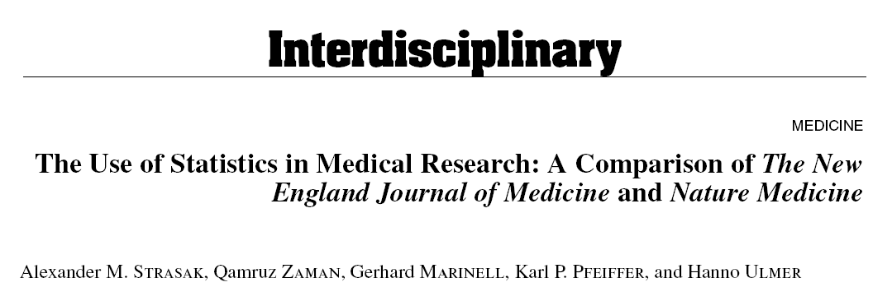
Stats in NEJM vs. Nature Medicine
All original research articles published during the first half of year 2004 in Volume 350, Numbers 1–26 of The New England Journal of Medicine and Volume 10, Numbers 1–6 of Nature Medicine were included for a bibliometric analysis.
NEJM n = 91
Nature Medicine n = 34

Slide 19
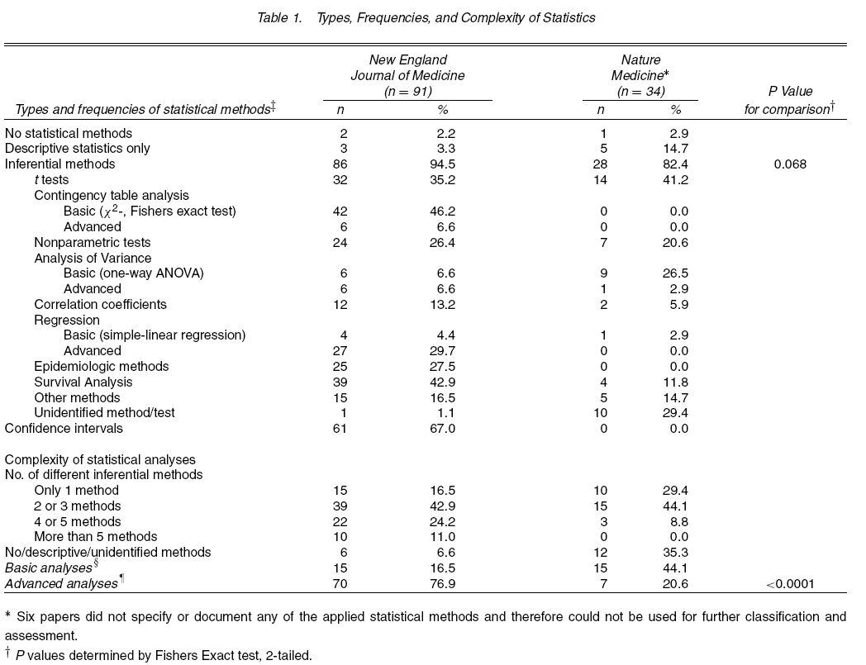
IF ~54
IF ~28

Slide 20
Classical vs. Open peer review
Approximately a third of higher impact journals purposefully use statisticians as reviewers
Some journals have open peer review whereby the reviewers’ identity is revealed to the authors (and often everyone else since public)
Some journals offer a choice between the two options
Some ask if the reviews can be “re-used” or passed forward
Controversial

Slide 21
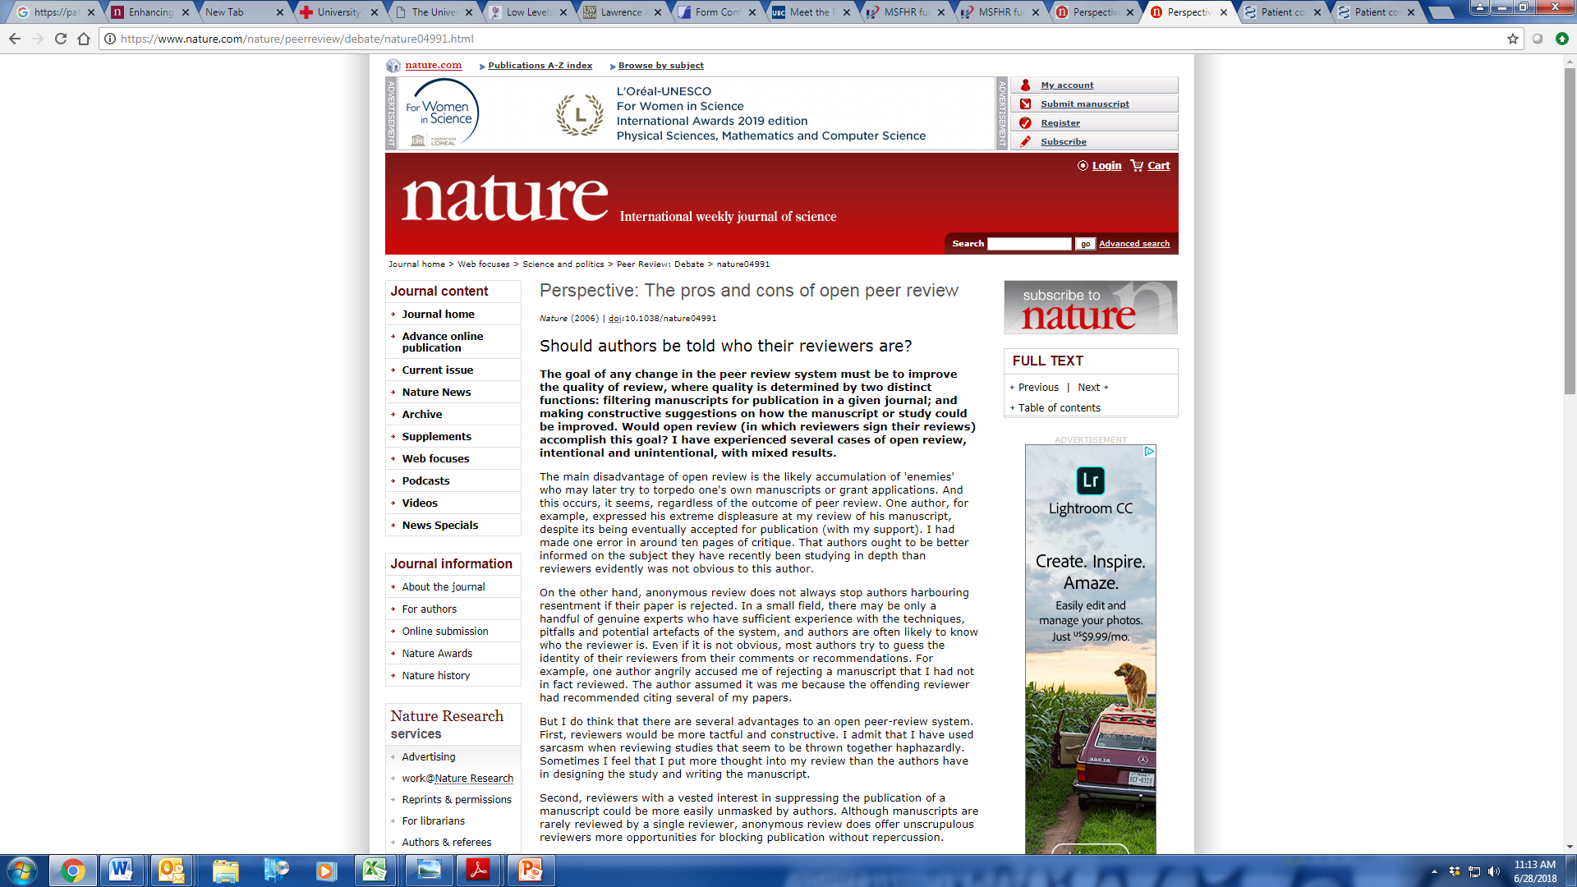
Classical vs. Open peer review

Slide 22
Resources
Lots of resources online and on each journal’s website about how to conduct a manuscript peer review

